Slide 1
LEIBNITZ THEOREM
Prepared by
Md Saif Kabir,
Lecturer, OAA

Slide 2
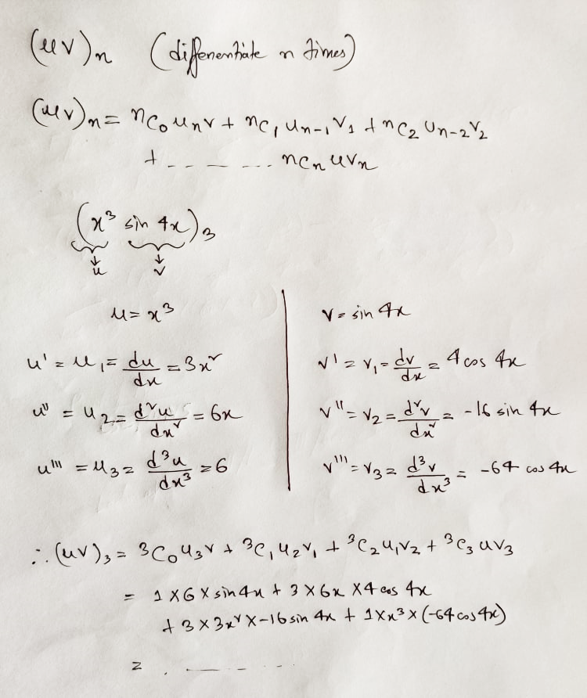

Slide 3
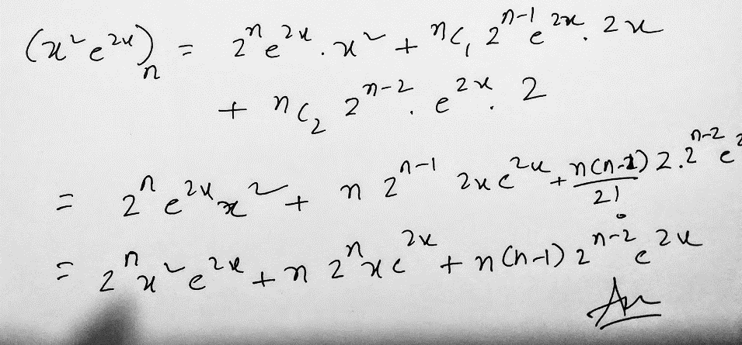

Leibniz Theorem

Slide 4
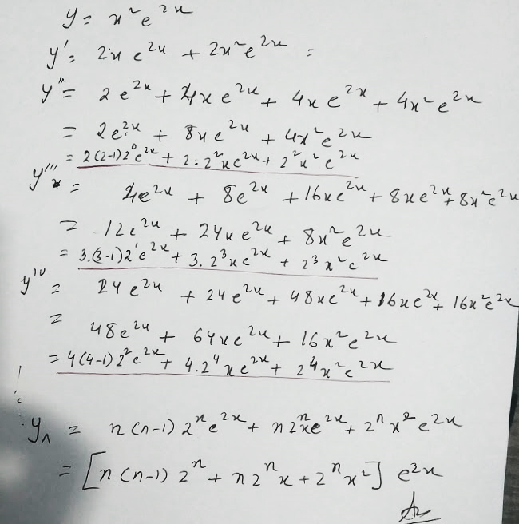

Slide 5
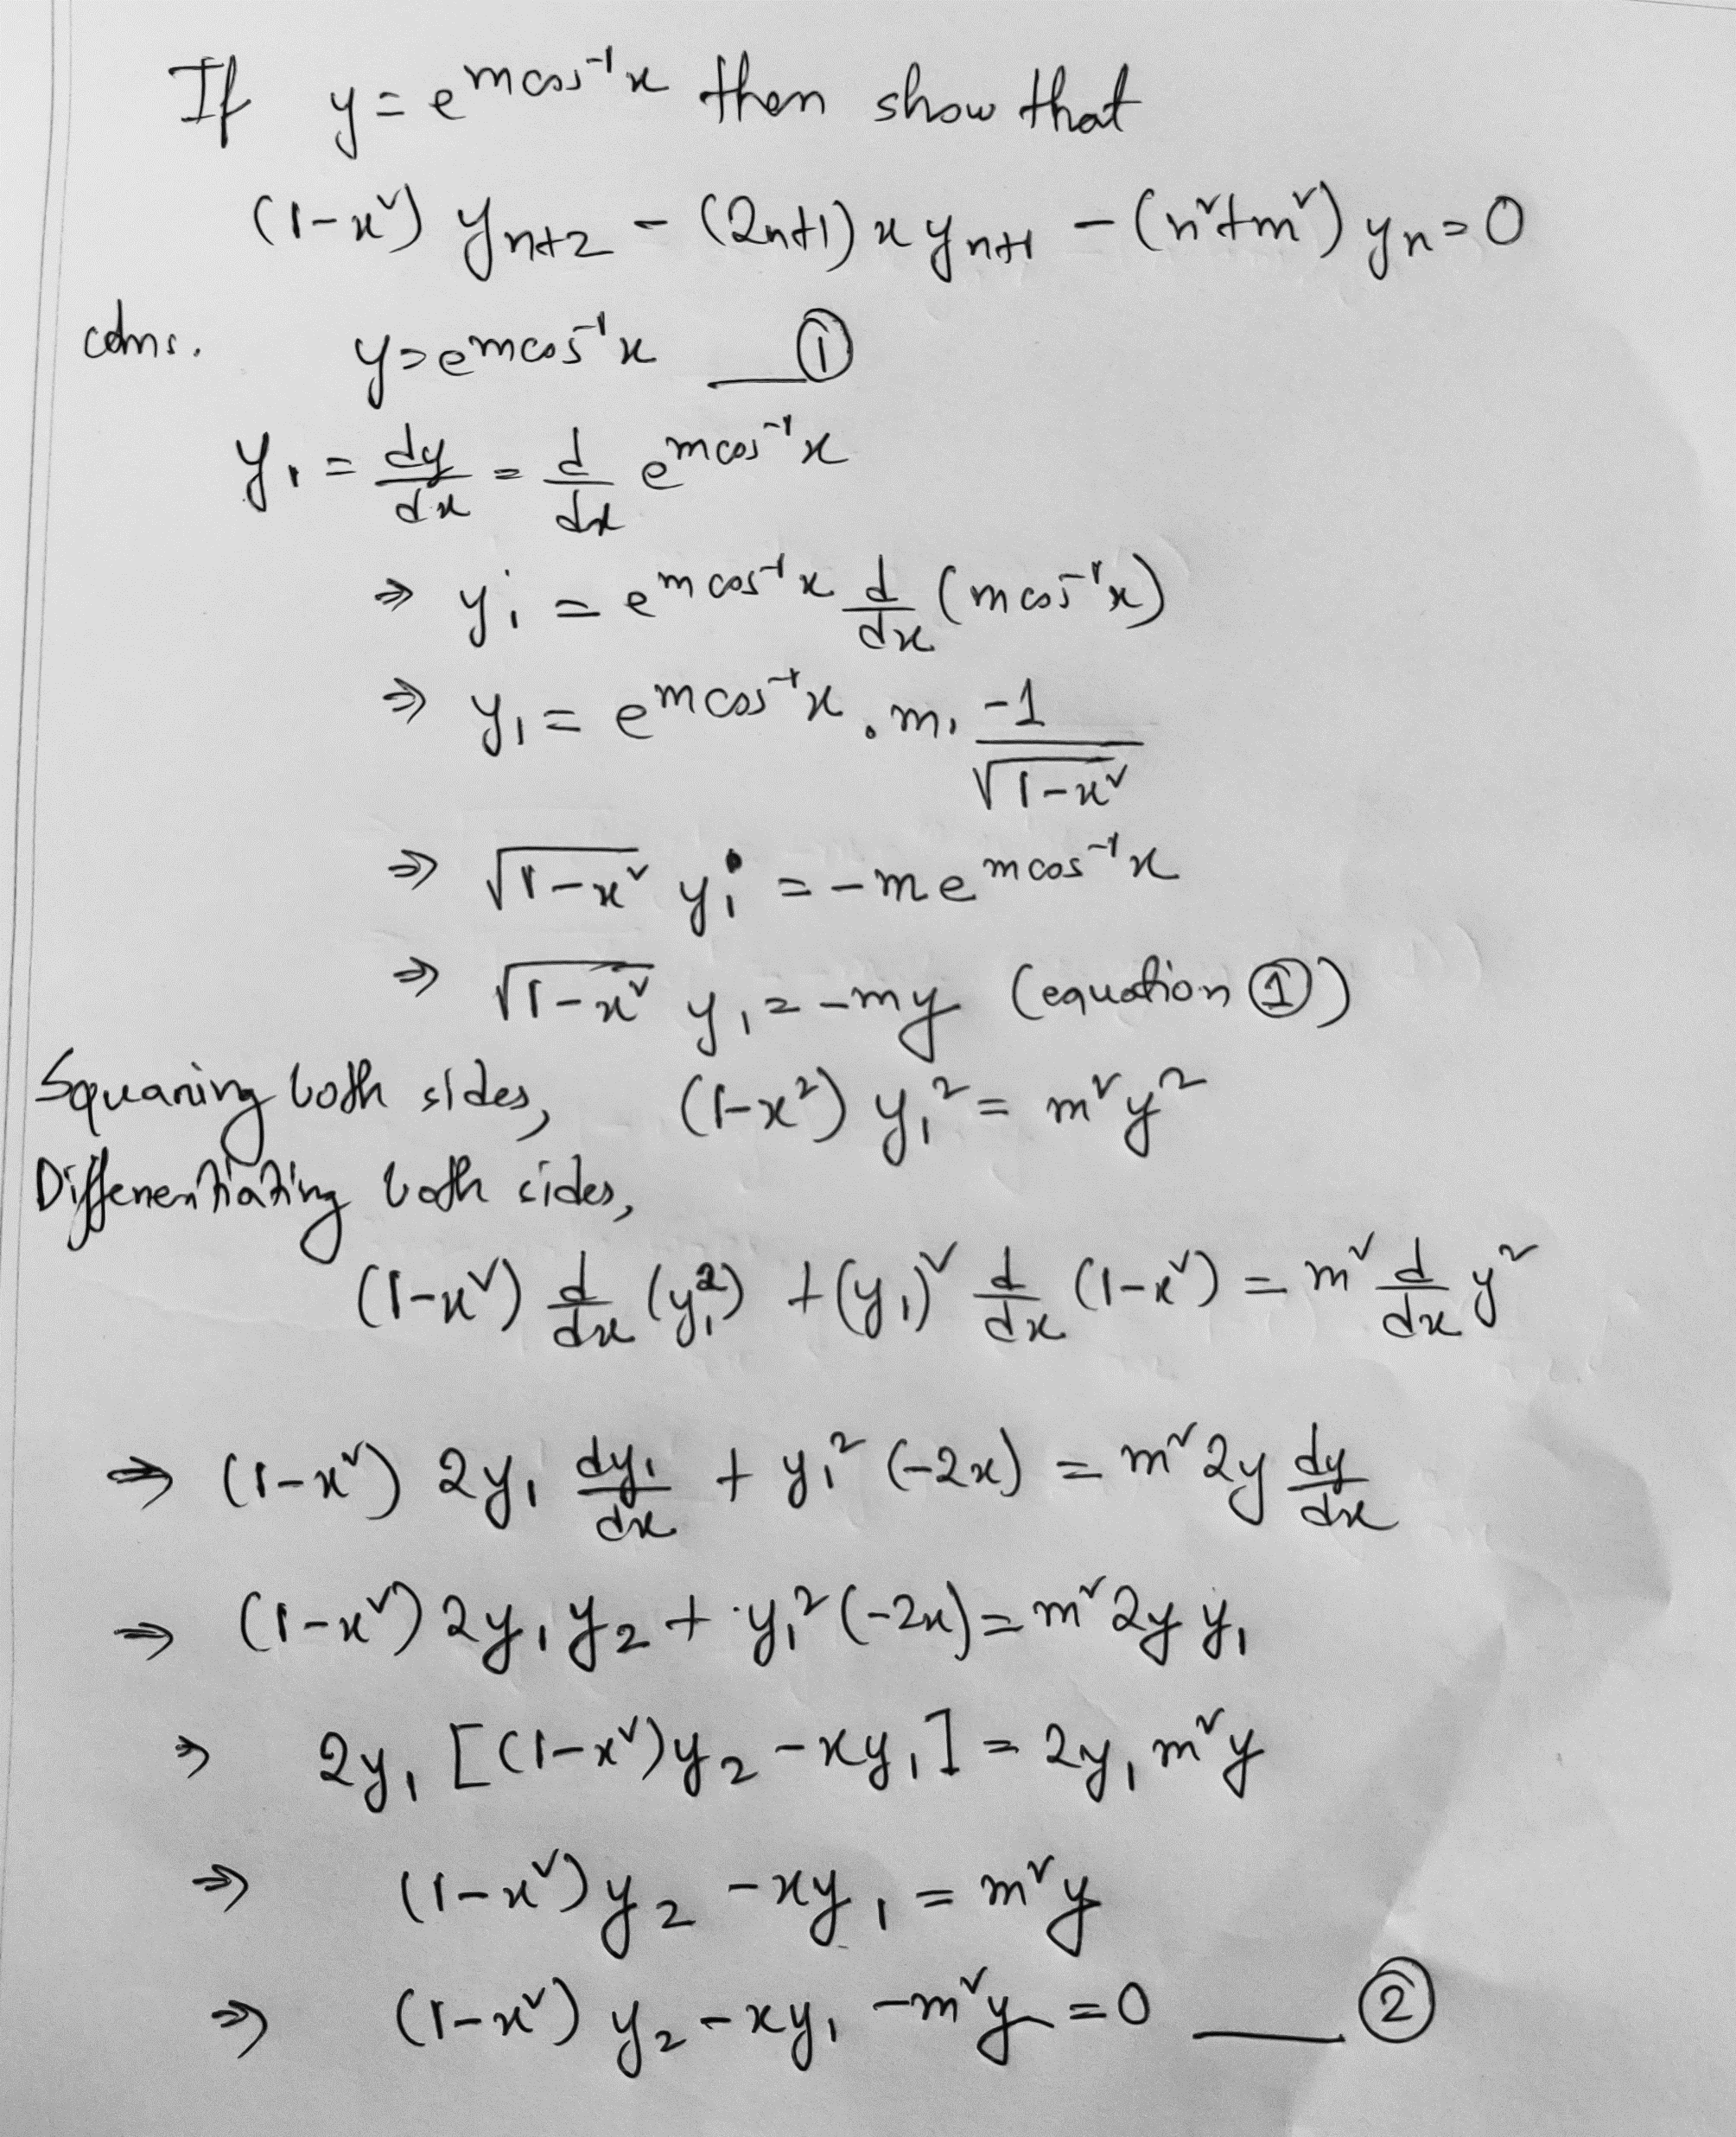



Slide 6
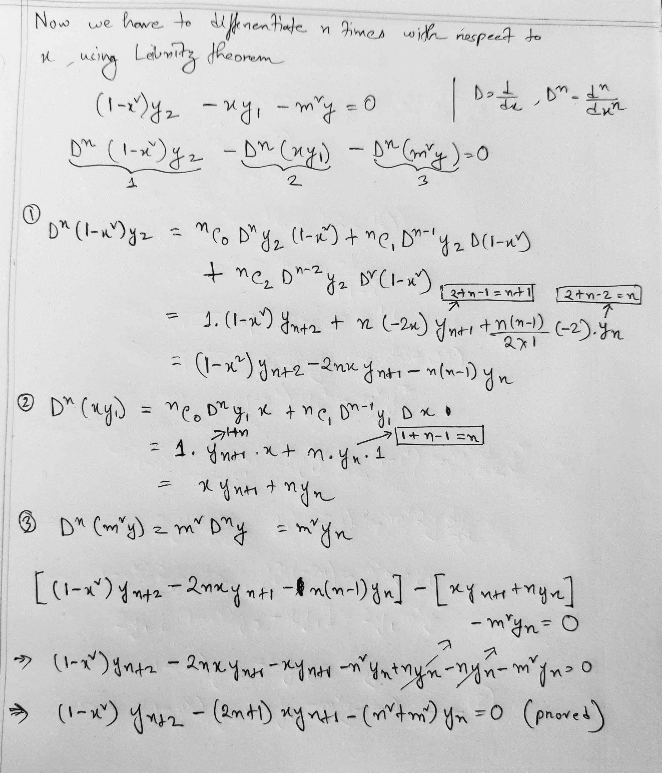

Slide 7
